Slide 1
CE313 COMPUTER COMMUNICATIONS & COMPUTER NETWORKS

Slide 2
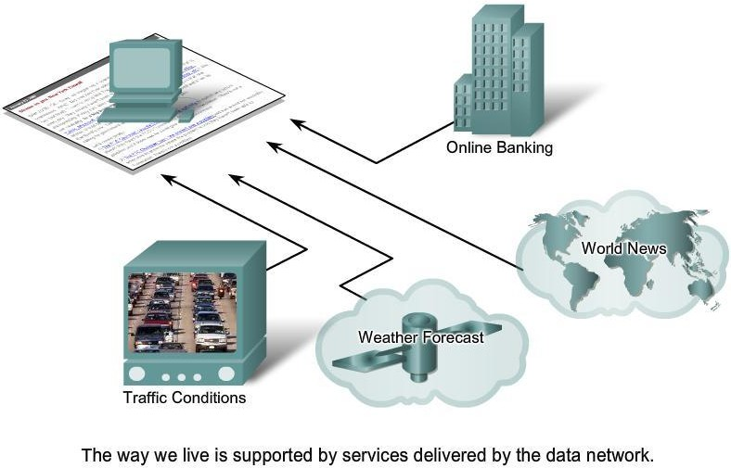
NETWORK SUPPORTING THE WAY WE LIVE

Slide 3
What is Communication?

Slide 4
What is Communication?
Communication is the process of exchanging information between two or more entities to convey meaning, intent, or data.

Slide 5
What is Data Communication?
Data communications is the exchange of data between two devices via some form of transmission medium.
Data refers to information presented in whatever form that is agreed upon by the parties creating and using the data.

Slide 6
Which of the following is NOT required for data communication?
A) Sender B) Receiver C) Transmission medium D) Internet connection

Slide 7
Which of the following is NOT required for data communication?
A) Sender B) Receiver C) Transmission medium D) Internet connection ✅ (Reinforces that data comm works over ANY medium—not just internet)

Slide 8
FUNDAMENTAL CHARACTERISTICS
Effectiveness of Data communications depends on following characteristics.
Delivery
Accuracy
Timeliness
Jitter

Slide 9
Jitter
What it is | Fluctuation in the time between successive packet arrivals (e.g., packets should arrive every 20ms, but arrive at 15ms → 35ms → 22ms)
Why it matters | Critical for real-time applications: • Voice/video calls → choppy audio/video • Online gaming → lag spikes • Live streaming → buffering
Jitter vs. Delay | • Delay (latency) = Total time for a packet to travel • Jitter = Variation in that delay between packets
Causes | • Network congestion • Route changes • Queuing delays at routers/switches • Variable processing times
Mitigation | Jitter buffers: Temporarily store incoming packets to smooth out delivery timing before playback/processing

Slide 10
Question
A live video call freezes for 2 seconds, then resumes with audio/video out of sync. Which TWO characteristics failed?

Slide 11
Question
A live video call freezes for 2 seconds, then resumes with audio/video out of sync. Which TWO characteristics failed?
Answer: Timeliness + Jitter (tests distinction between delay vs. variation in delay

Slide 12
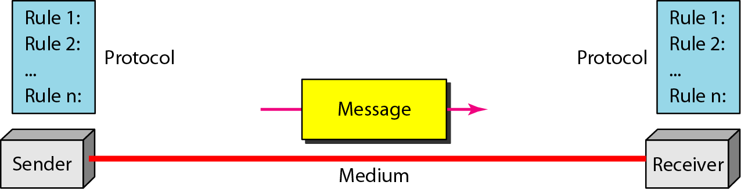
COMPONENTS OF DATA COMMUNICATIONS
Message
Sender
Receiver
Transmission medium
Protocol

Slide 13
PROTOCOLS
PROTOCOL
– A protocol is
a set of rules that govern data
communications; the key Elements of are syntax, semantics and timing.
Syntax
Structure or format of the data.
Semantics
Meaning of each section of bits.
Timing
a protocol
– When data should be sent, and how fast data can be sent.

Slide 14
Question
If two devices use the same cable but different protocols, will communication succeed? Why?

Slide 15
Question
If two devices use the same cable but different protocols, will communication succeed? Why?"
Key insight: Protocol mismatch = communication failure

Slide 16
Question
In human conversation, "grammar rules" map to which protocol element? A) Syntax B) Semantics C) Timing

Slide 17
Question
In human conversation, "grammar rules" map to which protocol element? A) Syntax ✅ B) Semantics C) Timing

Slide 18
DATA REPRESENTATION
Information can be sent in different forms
Text
Numbers
Images
Audio
Video

Slide 19
DATA FLOW
Communication between two devices can be:
Simplex
Half-Duplex
Full-Duplex

Slide 20
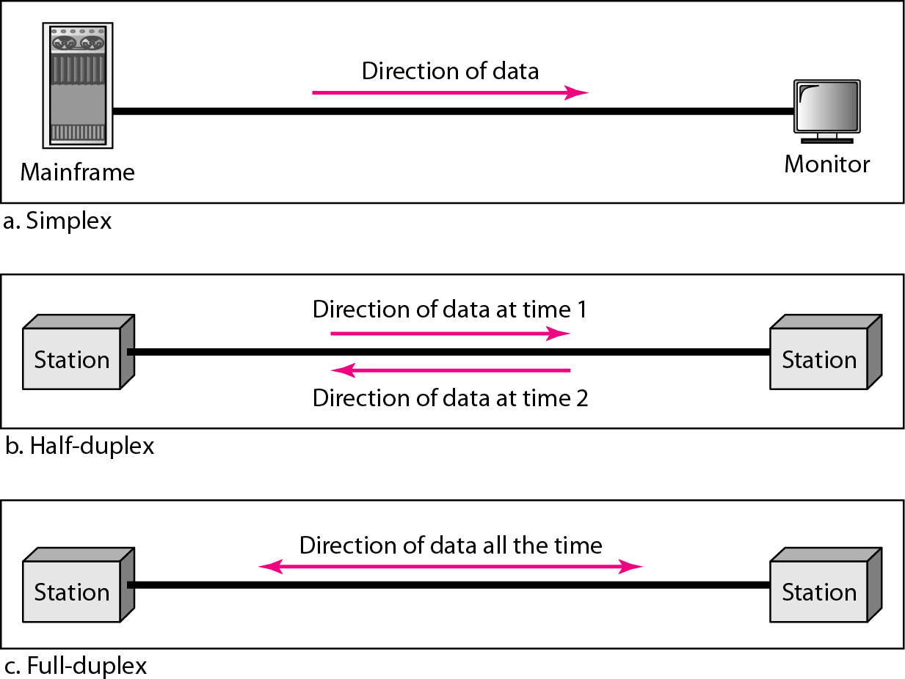
DATA FLOW

Slide 21
Question
Match the mode to the example:
Keyboard → Computer
Walkie-talkie
Phone call

Slide 22
Question
Match the mode to the example:
Keyboard → Computer
Walkie-talkie
Phone call
Answers: 1=Simplex, 2=Half-Duplex, 3=Full-Duplex

Slide 23










































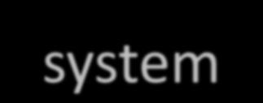


NETWORKS
A network is a set of devices (often referred to as nodes) connected by communication links. A node can be a computer, printer, or any other device capable of sending and/or receiving data generated by other nodes on the network.
An Interconnected system of things or people.

Slide 24
Distributed Processing
Most Networks uses distributed processing, in which task is divided among multiple computers.
Network Criteria
A network must be able to meet certain number of criteria, the most important are:
Performance
Reliability
Security

Slide 25
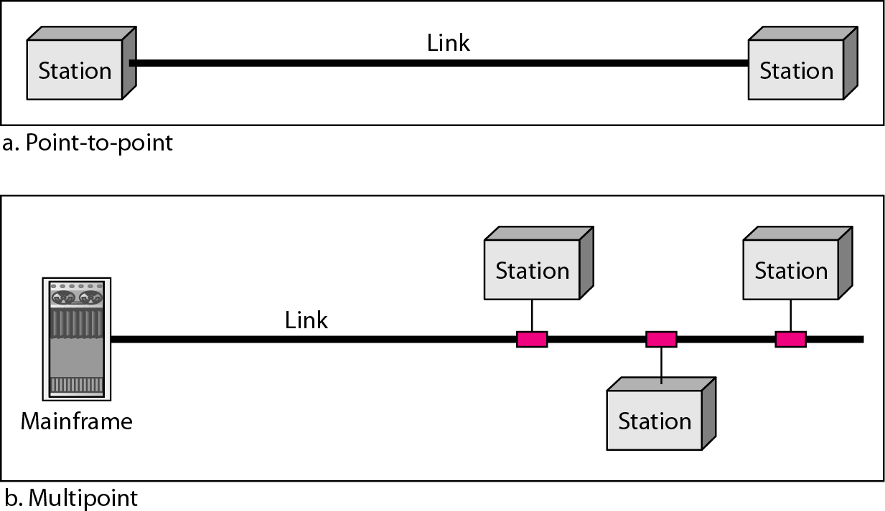
TYPES OF PHYSICAL CONNECTION
Point-to-Point Connection
Multipoint Connection

Slide 26
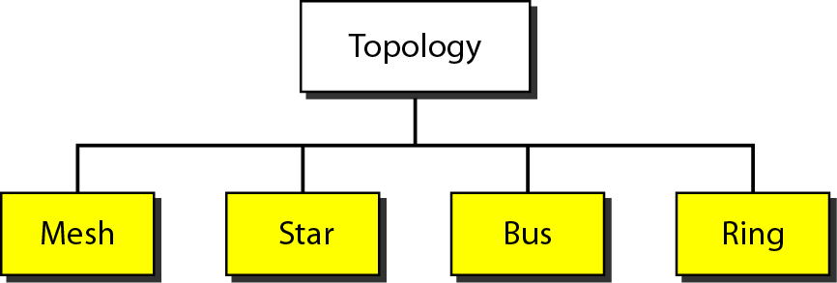
PHYSICAL TOPOLOGY
Way in which network is laid out physically. Two or more devices connect to a link; two or more links from a topology.

Slide 27
MESH TOPOLOGY
Every device has a dedicated point to point link to every other device.
A fully connected mesh network has n(n-1)/2 physical channels to link n device.
Every device must have n-1 I/O ports.
Advantages:
Eliminating traffic problems due to dedicated links.
Robust.
Privacy or security.
Easy for fault identification and isolation.
Disadvantages:
High cost due to amount of cabling and the network I/O ports required.
Difficult and complex installment.

Slide 28
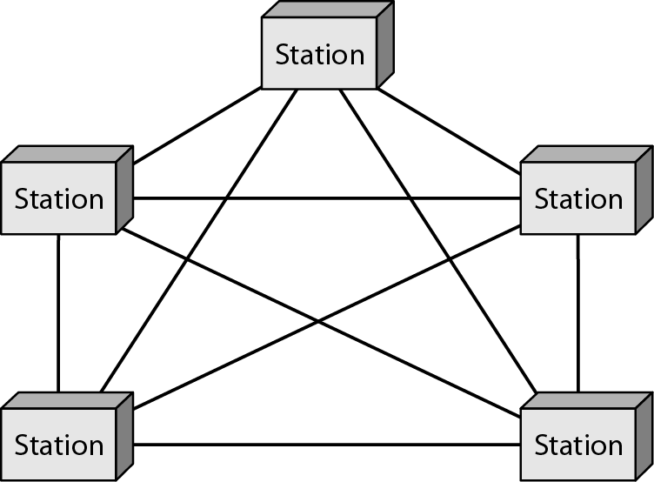
FULLY CONNECTED MESH TOPOLOGY (FIVE DEVICES)

Slide 29
Question
Calculation Sprint (15 sec): How many links in a fully connected mesh with 8 devices? A) 8 B) 28 C) 56 D) 64

Slide 30
Question
Calculation Sprint (15 sec): How many links in a fully connected mesh with 8 devices? A) 8 B) 28 ✅ (8×7/2) C) 56 D) 64

Slide 31
STAR TOPOLOGY
Each device has a dedicated point-to-point link only to a central controller, usually called hub.
Does not allow direct traffic between devices, the controller acts as an exchange.
Advantages:
Less expensive then mesh topology.
Easy to install and reconfigure.
Robust
Easy fault identification and fault isolation.
Disadvantages:
Could be costly due to Hub but still highly recommended due to its advantages over other topologies.

Slide 32
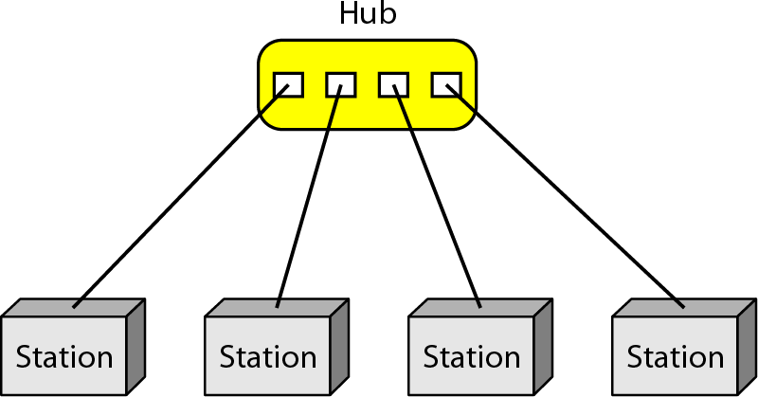
Star Topology with four stations

Slide 33
Question
Fault Analysis: In a 20-device star network, one computer fails. What happens? A) Whole network fails B) Only that device is isolated C) Half the network fails D) Hub overheats

Slide 34
Question
Fault Analysis: In a 20-device star network, one computer fails. What happens? A) Whole network fails B) Only that device is isolated ✅ C) Half the network fails D) Hub overheats → Reinforces robustness advantage

Slide 35
BUS TOPOLOGY
One long cable acts as a backbone (Bus) to link all other devices (nodes) in a network. Nodes are connected to the bus cable by drop lines and taps.
Mesh, Star are point to point. Bus is multipoint.
Propagating signal through the bus starts fading due to loss of energy as heat. Thus there is a limit on the number of taps and the distance between those taps.
Advantages:
Ease of installation.
Disadvantages:
Difficult reconnection.
Difficult fault isolation.
A fault or break in the bus cable stops all transmission to the further segment.

Slide 36
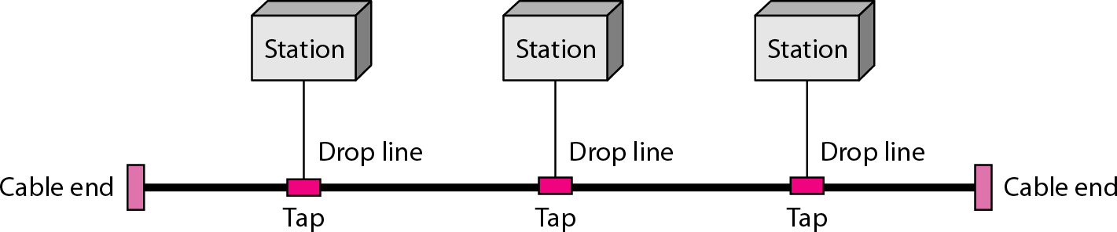
Bus Topology Connecting three stations.

Slide 37
Question
Why does a break in the bus cable disable devices AFTER the break but not before it?

Slide 38
Question
Why does a break in the bus cable disable devices AFTER the break but not before it?
Answer: Signal propagates linearly from sender; break blocks further propagation (tests understanding of signal flow)

Slide 39
RING TOPOLOGY
Each device has a dedicated point-to-point connection only with the two devices on either side of it. A signal is passed along the ring in one direction, from device to device, until it reaches its destination.
Each device in the ring incorporates a repeater.
Advantages:
Easy to install and reconfigure with considerations like maximum ring length and number of devices.
Simplified fault isolation.
Disadvantage:
Due to unidirectional traffic, a break in the ring can disable the entire network.

Slide 40
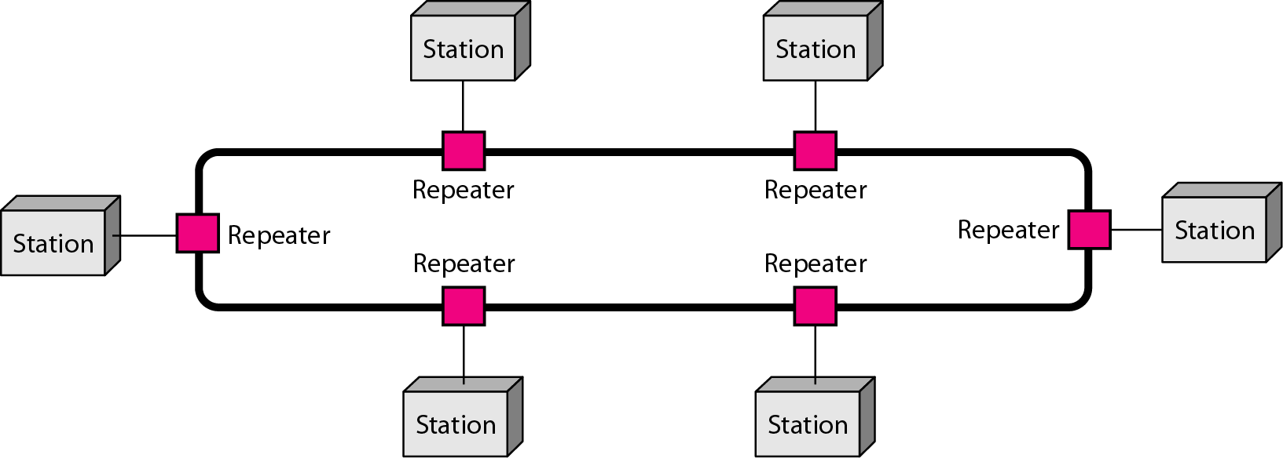
Ring Topology connecting six stations.

Slide 41
Question
True/False Rapid Fire: In ring topology, a repeater in each device amplifies signals to prevent degradation

Slide 42
Question
True/False Rapid Fire: "In ring topology, a repeater in each device amplifies signals to prevent degradation." ✅ TRUE (Reinforces why rings can span longer distances than bus)

Slide 43
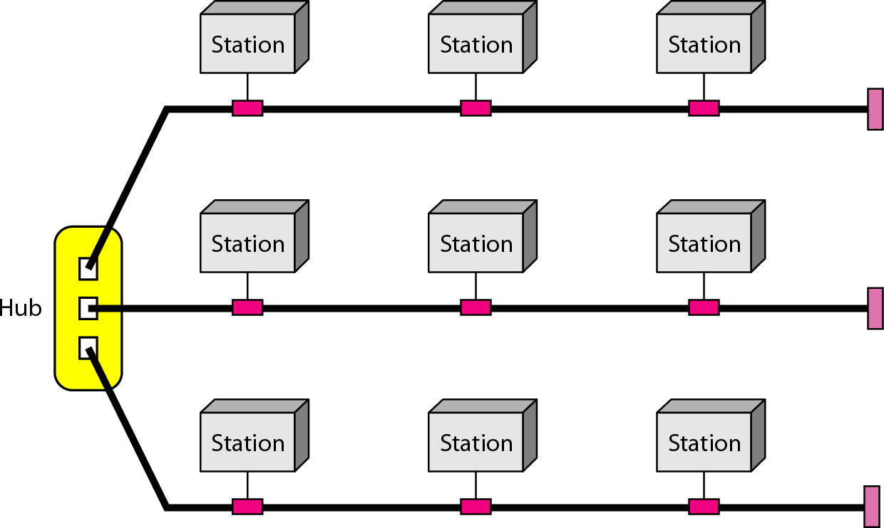
HYBRID TOPOLGY

Slide 44
CATEGORIES OF NETWORK
Network
Local area network (LAN)
Metropolitan area network (MAN)
Wide area network (WAN)

Slide 45
LOCAL AREA NETWORK
Usually privately owned and links the devices in a single office, building or campus.
Geographical size is few kilometers.
Designed to allow resources (hardware, software or data) to be shared between personal computers or work stations.
In general use one type of media.
Topologies: bus, ring and star.
Data rates: 4 to 16 Mbps. Recent advancements support up to 100 Mbps and Gbps is in development.

Slide 46
Question
Which topology is LEAST common in modern LANs? A) Star B) Bus C) Mesh D) Ring

Slide 47
Question
Which topology is LEAST common in modern LANs?
A) Star ✅ (Most common today) B) Bus ❌ (Legacy Ethernet) C) Mesh ❌ (Rare due to cost) D) Ring ❌ (Token Ring obsolete)

Slide 48
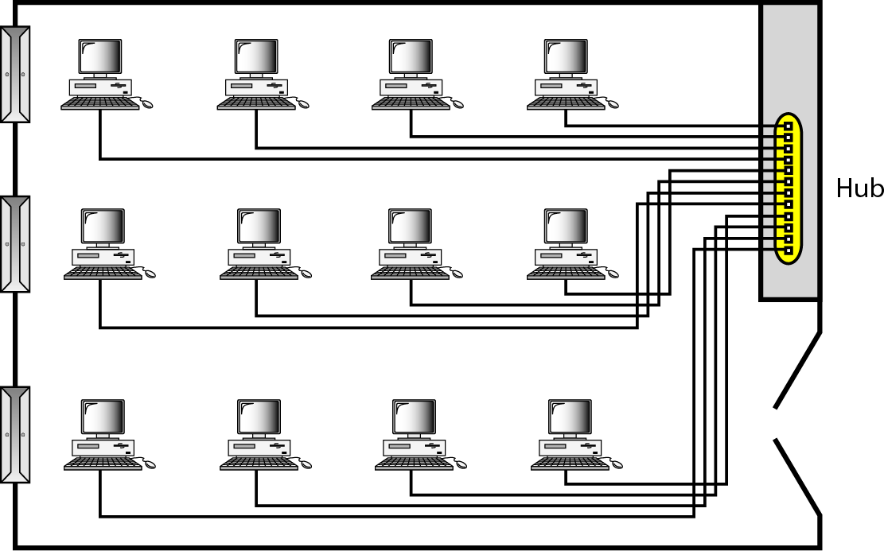
LAN connecting 12 computers in a Hub

Slide 49
METROPOLITAN AREA NETWORK
Designed for the customers who need a high speed connectivity, normally to the internet and spread over a city or part of city.
Maybe a single network or maybe a means of connecting number of LANs into a larger network so that resources may be shared LAN-to-LAN as well as device-to-device.
Example: A company can use a MAN to connect LANs in all its offices throughout a city.

Slide 50
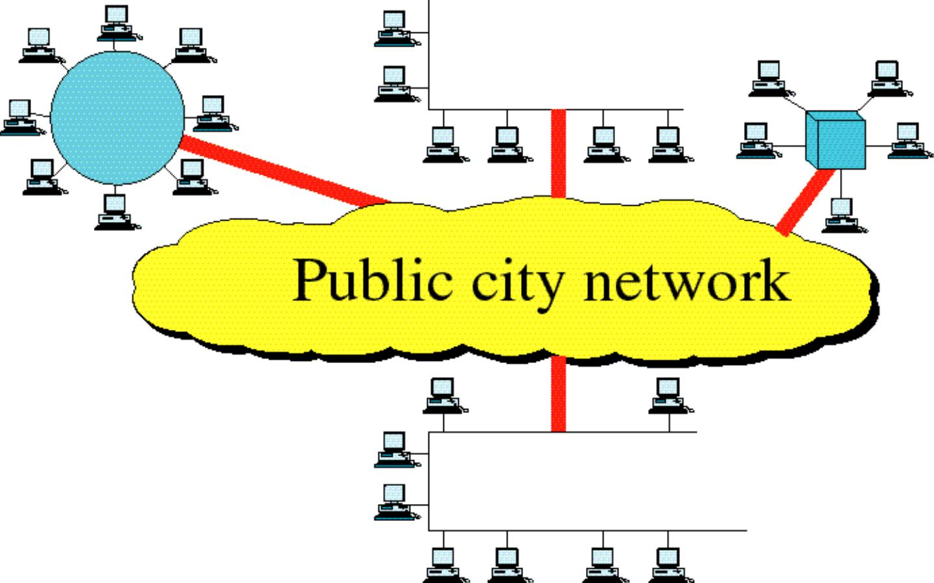
Metropolitan Area Network

Slide 51
Question
A university has campuses across a city. Each campus has its own LAN. What network type connects them for shared library resources?

Slide 52
Question
A university has campuses across a city. Each campus has its own LAN. What network type connects them for shared library resources?"
→ Answer: MAN

Slide 53
WIDE AREA NETWORK
Provides long distance transmission of data, voice, image and video information over large geographic areas that may comprise a country, a continent, or even the whole world.
Switched WAN:
connects the end systems, which usually comprise a router (internetworking connecting device) that connects to another LAN or WAN
complex as the backbones that connect the Internet.
Point-to-Point WAN:
A line leased from a telephone or cable TV provider that connects a home computer or a small LAN to an Internet service provider (lSP).
simple as a dial-up line that connects a home computer to the Internet

Slide 54
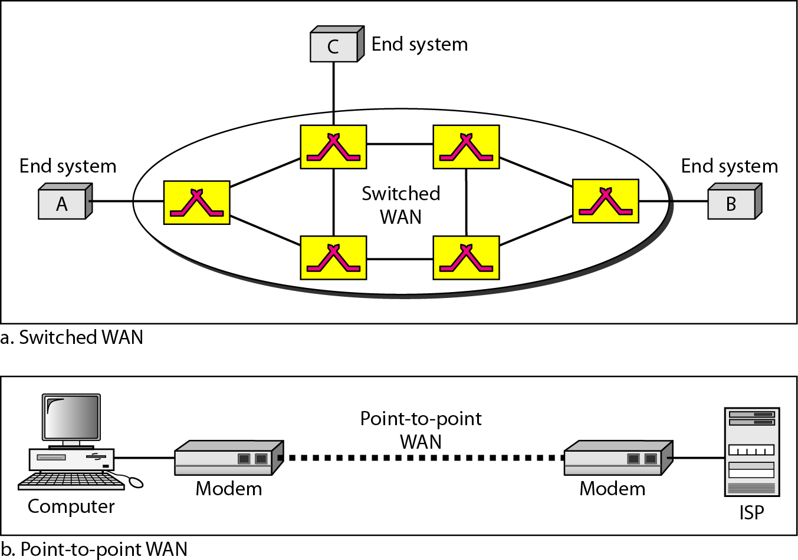
A Switched WAN & Point-to-Point WAN

Slide 55
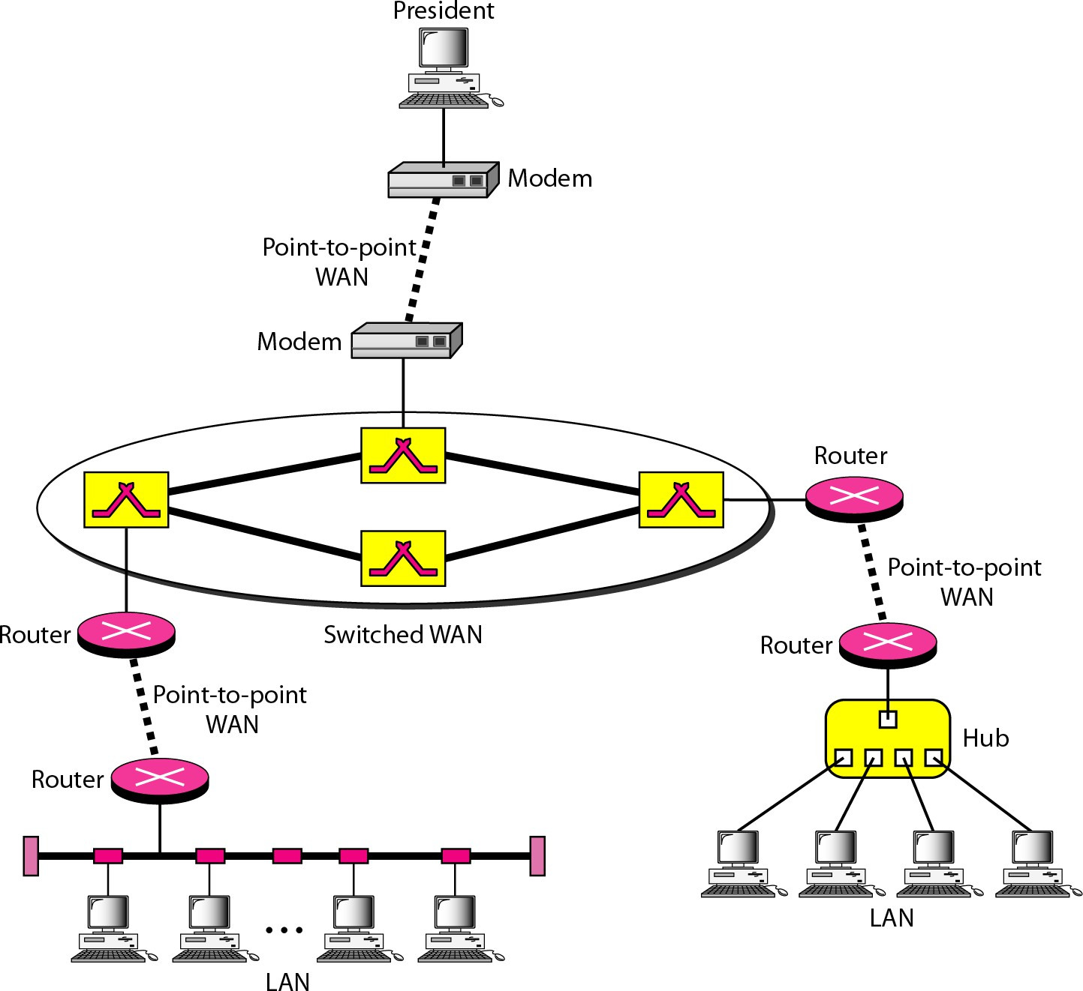
A Heterogeneous Network made of 4 WANs and 2 LANs

Slide 56
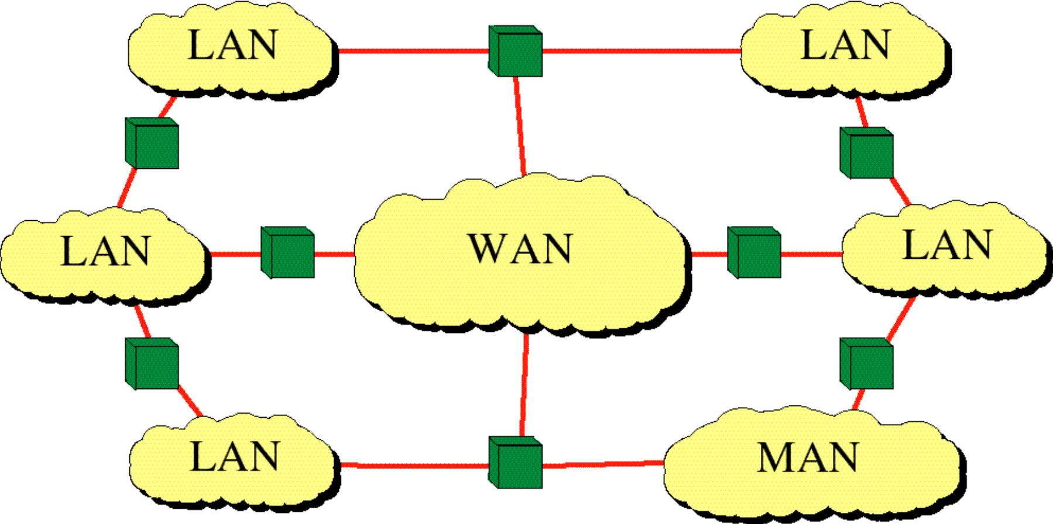
INTERNET

Slide 57
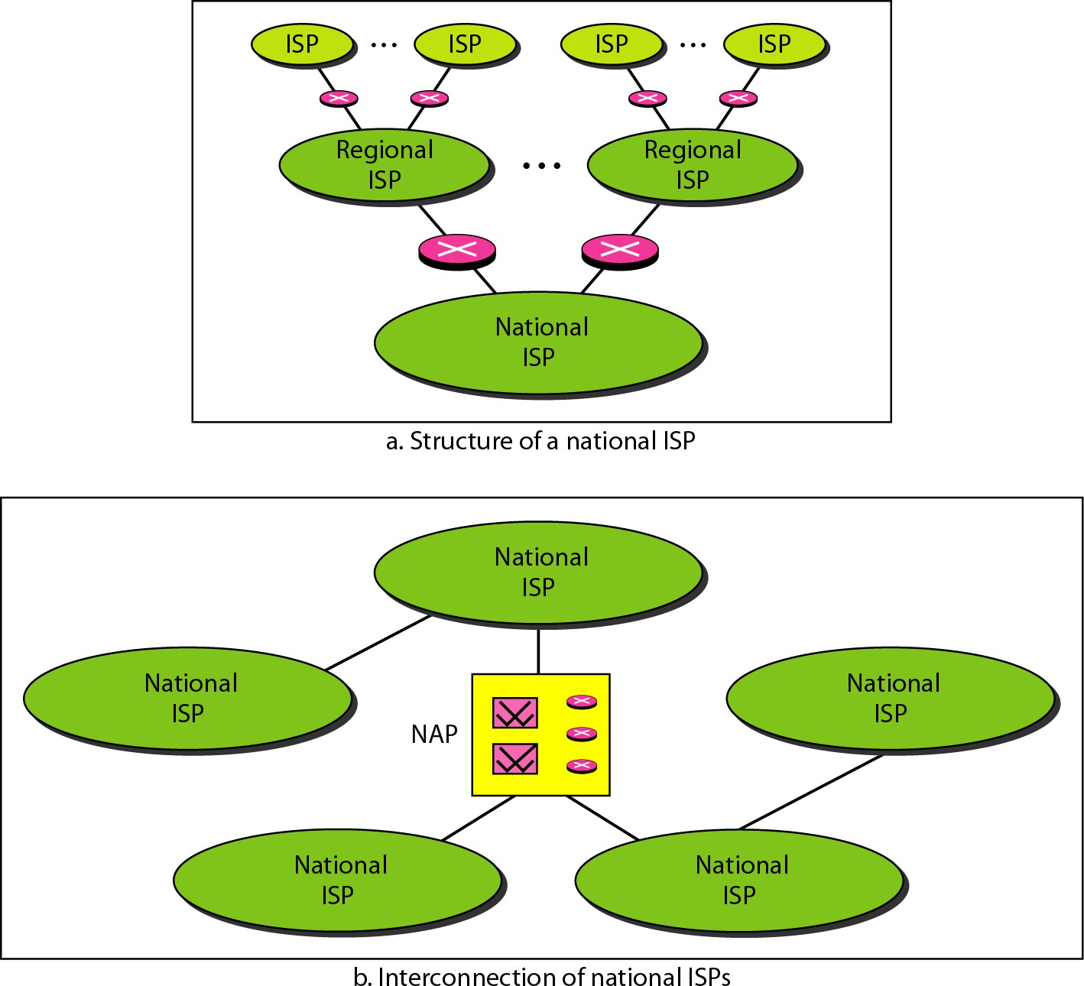
Hierarchical Organization of Internet

Slide 58
Question
Which WAN type uses routers to dynamically route traffic between multiple paths?

Slide 59
Question
Which WAN type uses routers to dynamically route traffic between multiple paths?
→ Answer: Switched WAN (distinguishes infrastructure complexity

Slide 60
STANDARDS
Standard products
are necessary to ensure that from different manufacturers can
work together as expected.
Data Communication Standards fall in to two categories.
De facto
De jure

Slide 61
STANDARD ORGANIZATIONS
International Organization for Standardization (ISO)
International Telecommunication Union- Telecommunication Standards Sector (ITU-T)
American National Standards Institute (ANSI)
Institute of Electrical and Electronics Engineers (IEEE)
Electronics Industries Association (EIA)

Slide 62
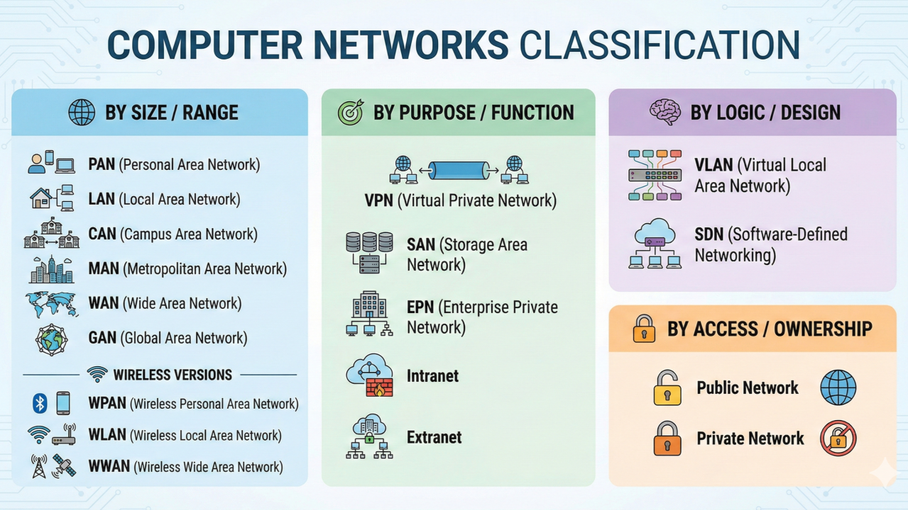

Slide 63
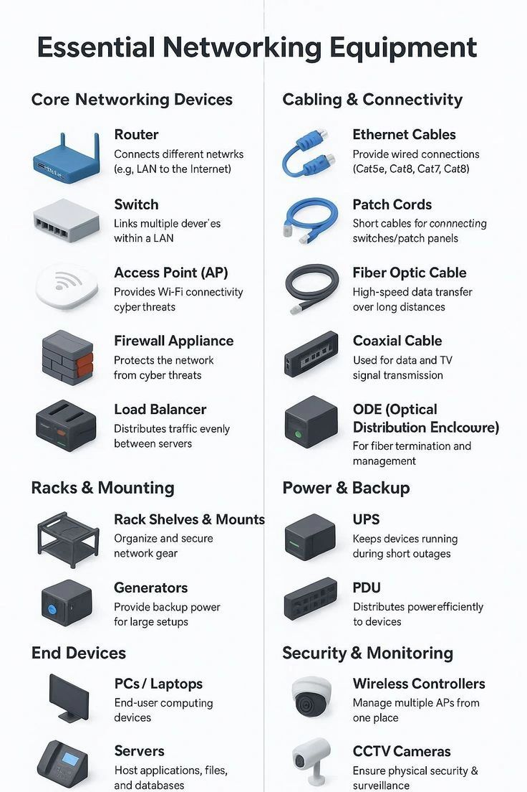

Slide 64
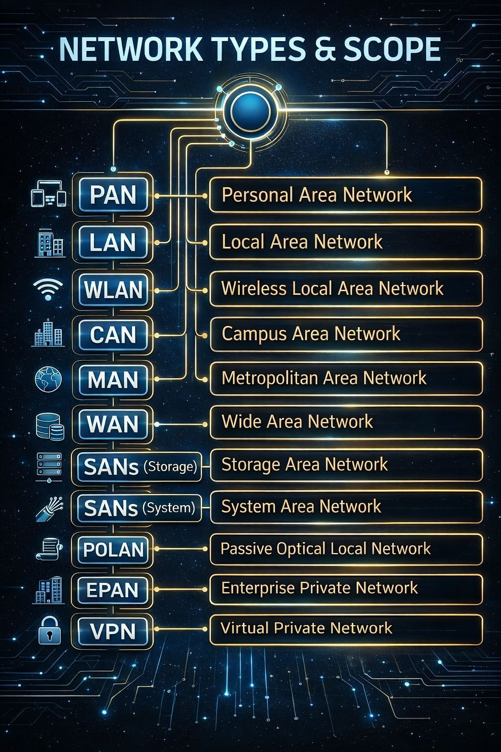

Slide 65
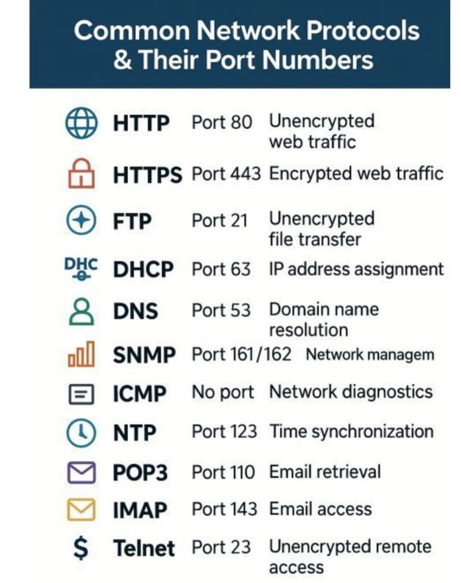

Slide 66
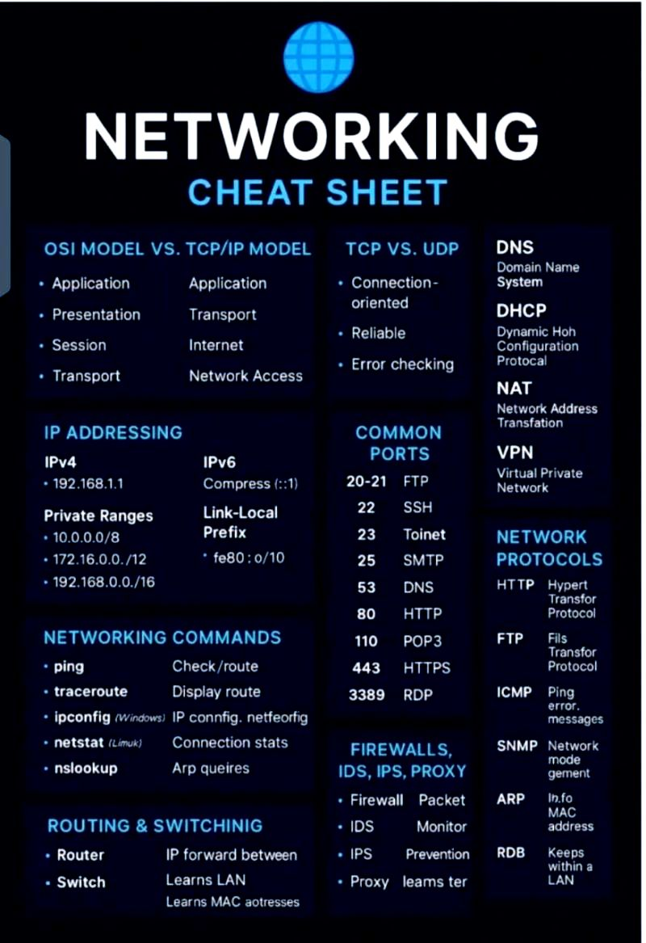

Slide 67
To-Do List
At least go through all the slides once in order to grasp the concept before the next lecture.
Join the Group Home page as soon as possible.
Lecture Slides for the next lecture will be uploaded on the group home page before the lecture.
Any concern regarding the course, email on the engr.ahmad.Nawaz@giki.edu.pk

